Slide 1
Covariates

Slide 2
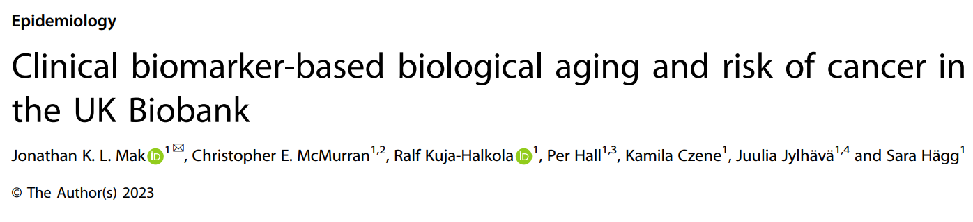
UKB基于临床生物标记物的生物老化和癌症风险

Slide 3
Covariates-Sociodemographic and health-related factors
Year of birth
Baseline assessment center
Ethnic background
Body mass index categories
Education level
Deprivation index quintiles
Self-reported diabetes

Slide 4
Covariates-Lifestyle factors&Diet
Smoking status
Alcohol intake frequency
Physical activity level
Fresh vegetable and fruit intake
Red meat intake
Processed meat intake

Slide 5
Covariates-Family history of cancers & Melanoma-related factors
Family history of breast
Family history of prostate cancer前列腺癌
Family history of lung cancer肺癌
Family history of colorectal cancer结直肠癌
Time spent outdoors during summer
Sunburn during childhood
Solarium/sunlamp use
Ease of skin tanning
Skin color
Hair color
Use of sun/UV protection

Slide 6
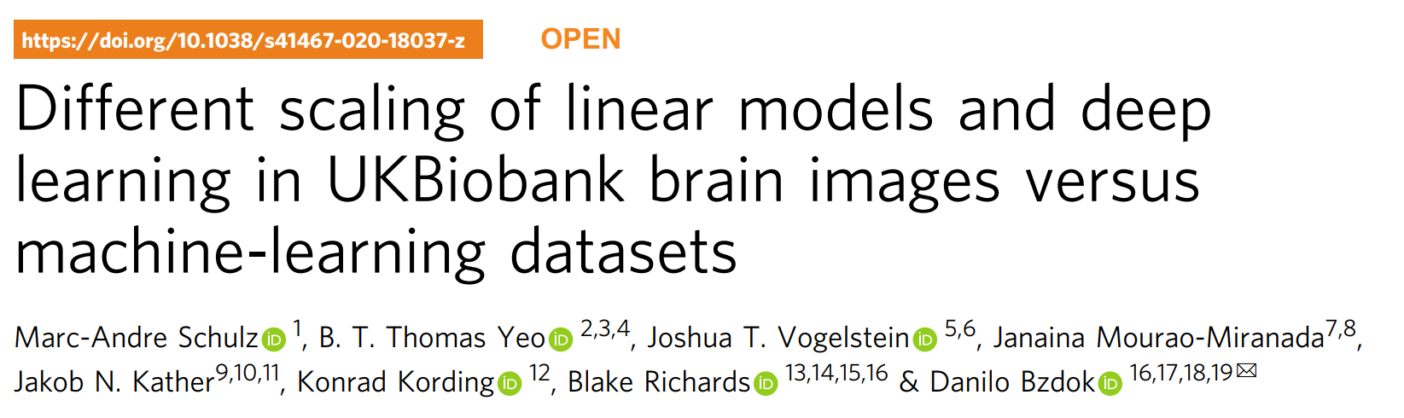
UKB大脑图像与机器学习数据集中线性模型和深度学习的不同缩放

Slide 7
Covariates
Sex
Age
Fluid intelligence
Household income
household size

Slide 8
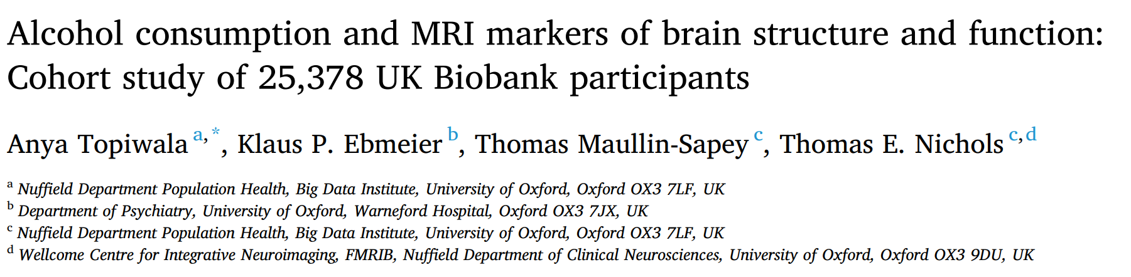
饮酒和大脑结构和功能的MRI标记：25378名UK Biobank参与者的队列研究

Slide 9
Variables of interest were included as potential confounders because of associations with neuroimaging measures:
age at scanning and sex
smoking status (reported in categories:never/previous/current)
educational qualifications
systolic (SBP) 收缩压and diastolic (DBP) 舒张压blood pressure
Body mass index (BMI)
Townsend Deprivation Index汤森剥夺指数
weekly exercise expenditure
diabetes mellitus diagnoses
depression cases

Slide 10

炎症与抑郁和焦虑的关系：症状特异性和潜在因果关系的来自UK Biobank和NESDA cohorts的证据

Slide 11
Covariates
age
sex
socioeconomic status (SES)（measured via the Townsend Deprivation Index ）
smoking (current/former/never)
quantity of alcohol consumption
type and time spent in physical activity
lifetime history of type two diabetes (T2D)
cardiovascular diseases(CVD)
body mass index (BMI)

Slide 12
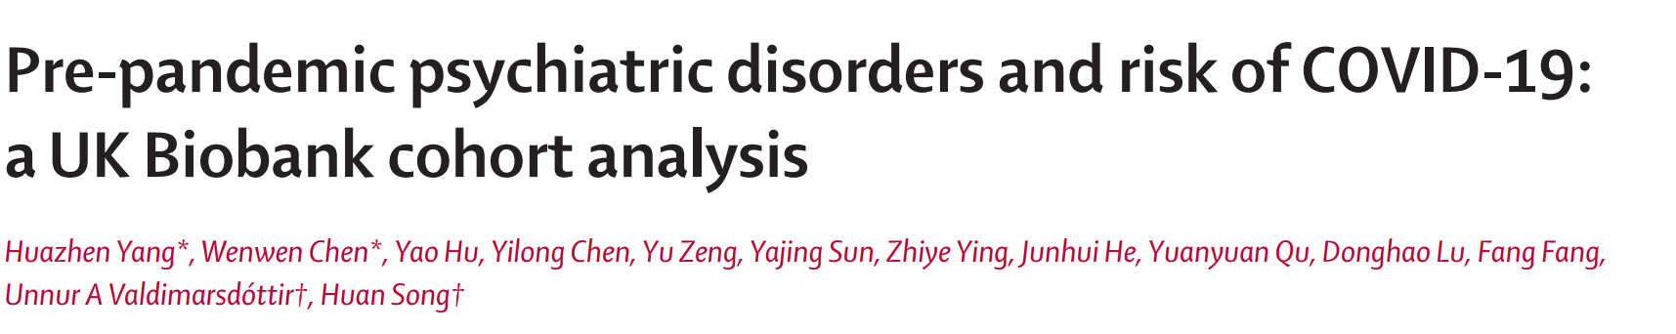
流行前精神障碍与新冠肺炎风险： UK Biobank队列分析

Slide 13
Covariates
sociodemographic characteristics (birth year, sex, and race or ethnicity)
socioeconomic factors (Townsend deprivation index, educational attainment, and annual household income)
lifestyle factors (smoking status)
Bodymass index (BMI)
Townsend deprivation index
history of somatic diseases that could affect COVID-19 susceptibility or course

Slide 14
UK Biobank : Data Dictionary for Application 68640
UK Biobank : Data Dictionary for Application 68640
UDI - the Unique Data Identifier for an item of data within the UK Biobank repository.
Count - the number of non-empty rows present in this dataset.

Slide 15
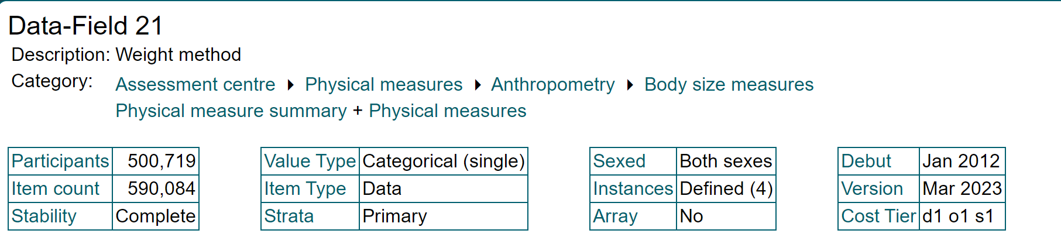
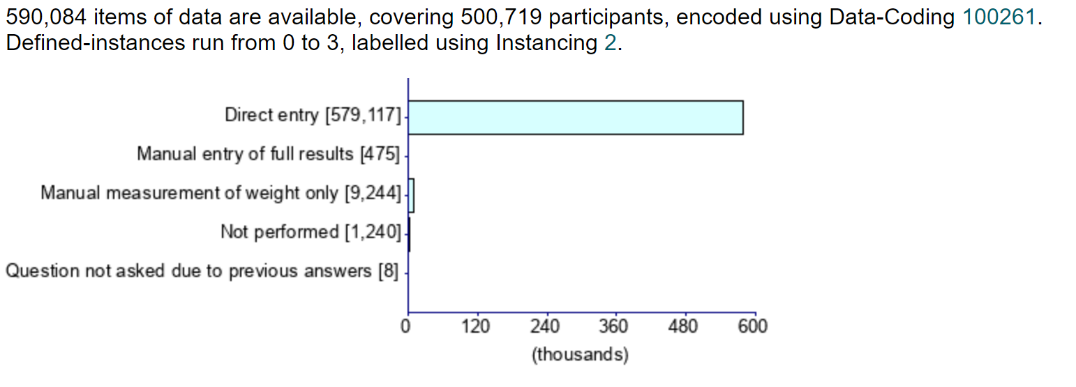
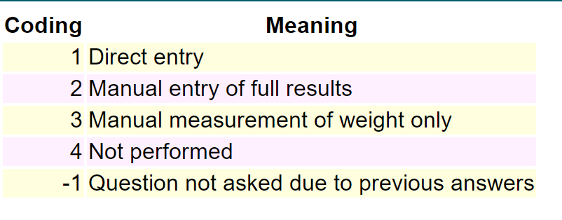
Weight method 21-0.0
Indicates whether weight was entered into the machine directly or manually, whether weight was only measured manually or not performed

Slide 16
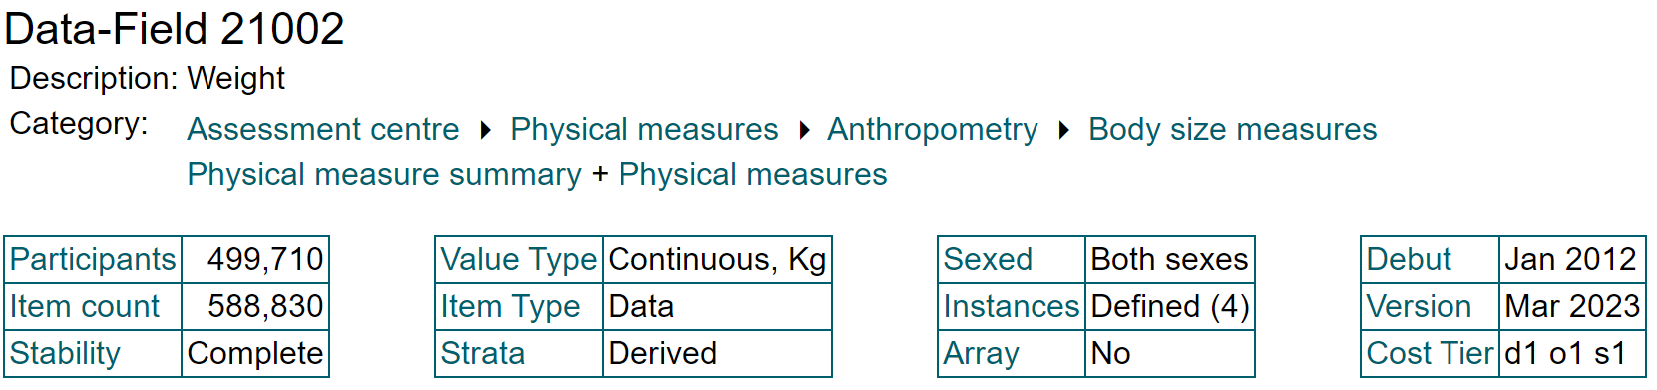
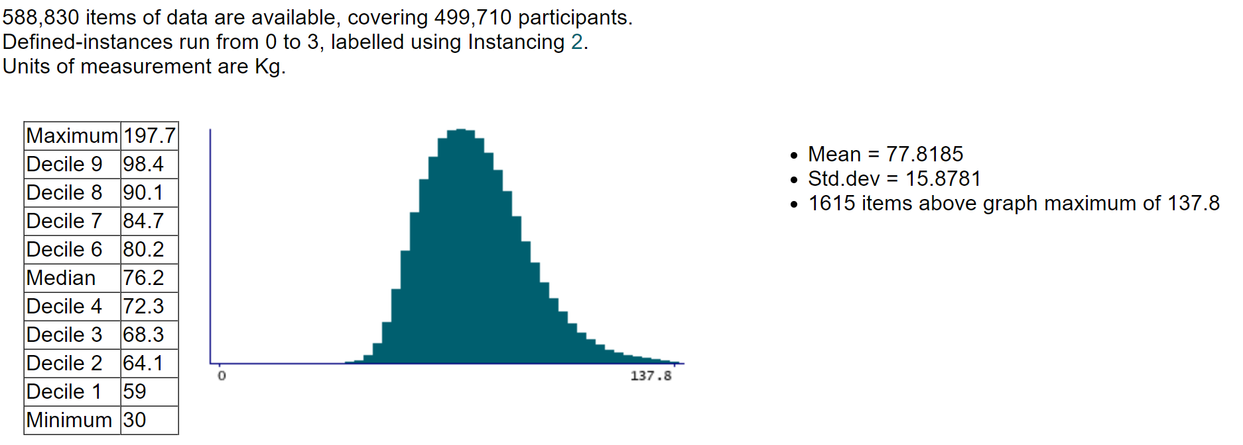
Weight 21002-0.0

Slide 17
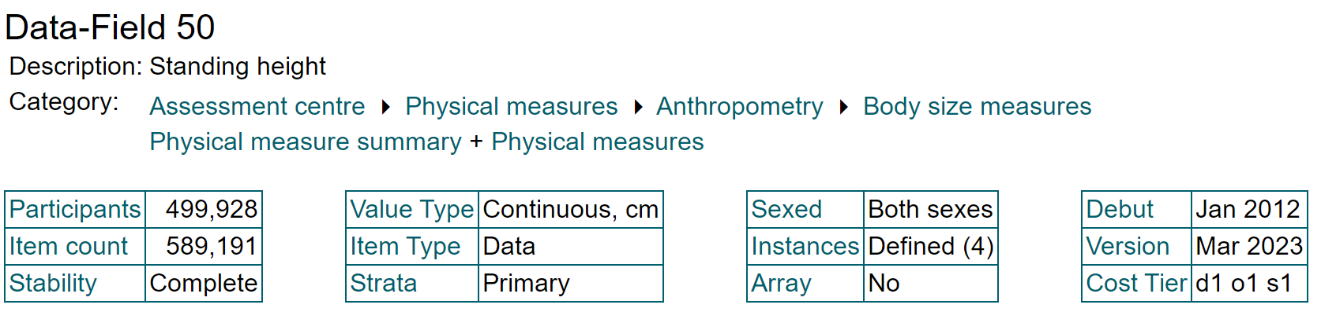
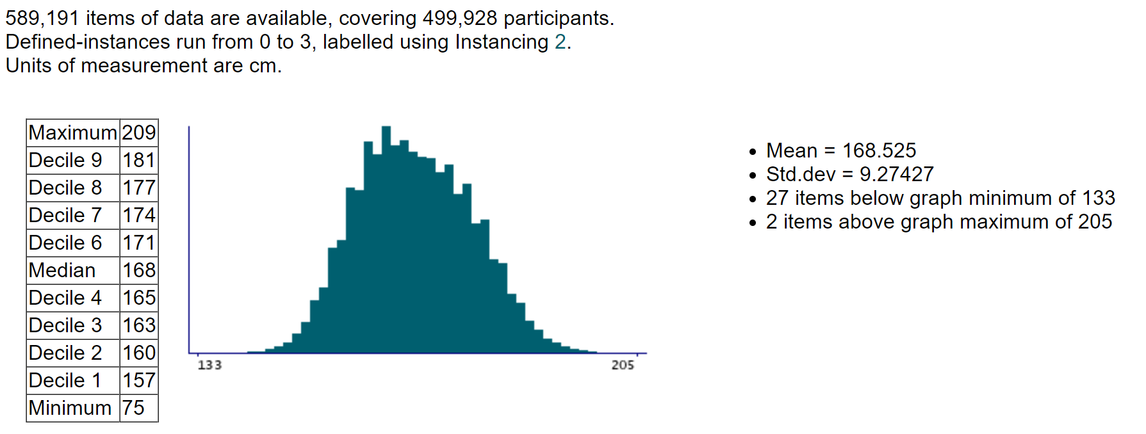
Standing height
Standing height was measured using a Seca 202 device

Slide 18
Standing height
Resource 100141
Resource 100142
Name: Height measurement
Size: 1,226,740
MD5: 16b3bac05a9d4d0f4bf450099ee2b029
Participant having standing height measured
Name: Height positioning
Size: 1,540,449
MD5: 508f13c90736694192f202d1324ee58d
Participant being put into correct position for height measurement

Slide 19
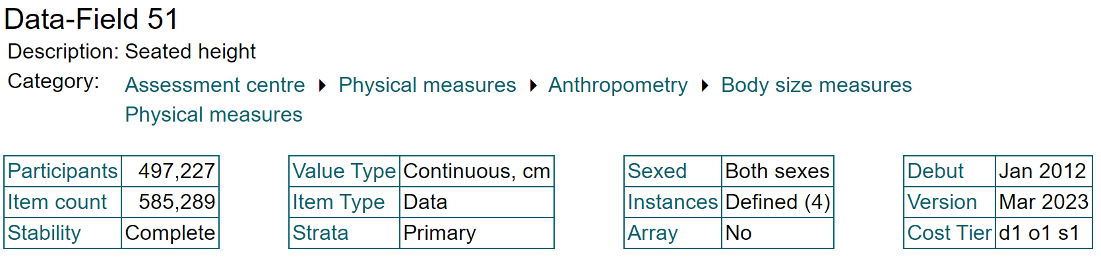
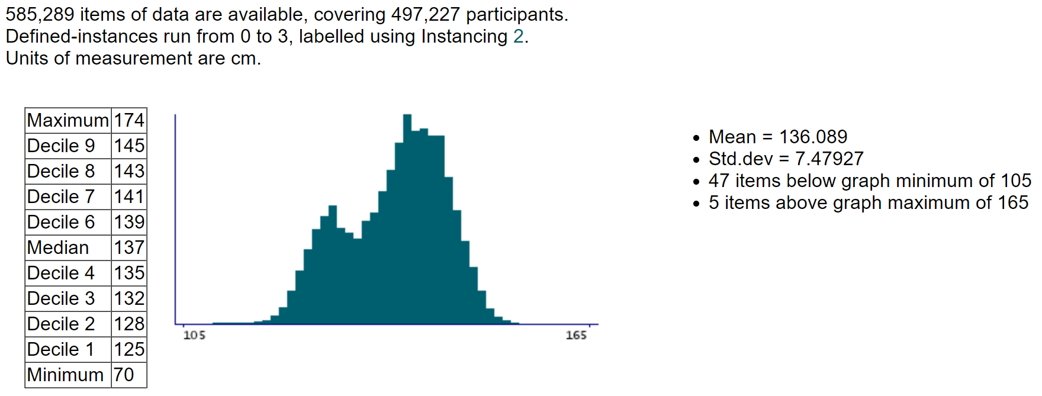
Seated height

Slide 20
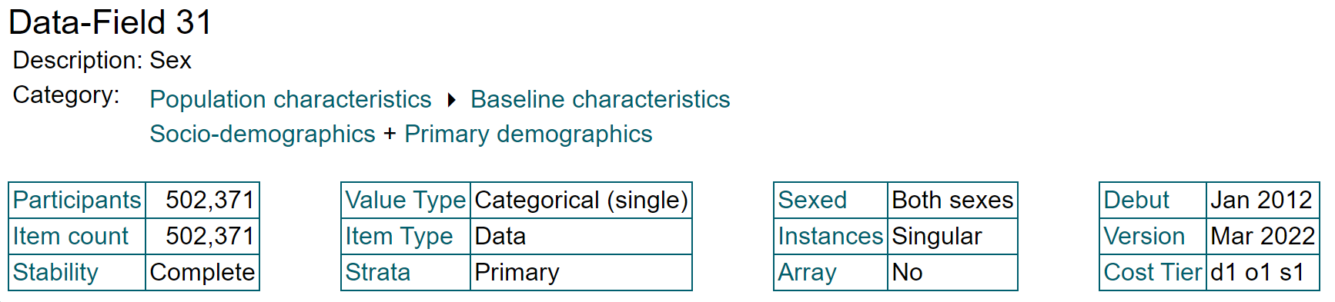
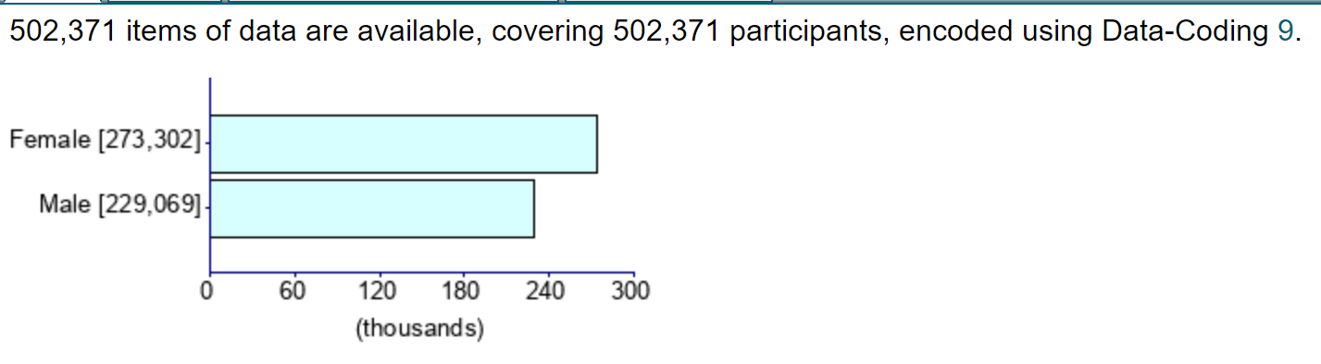
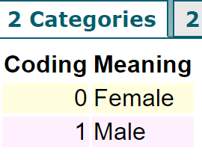
Sex 31-0.0

Slide 21
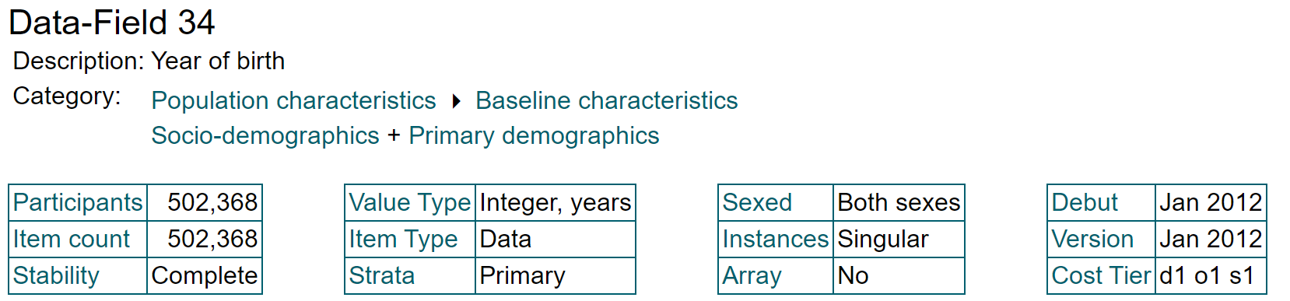
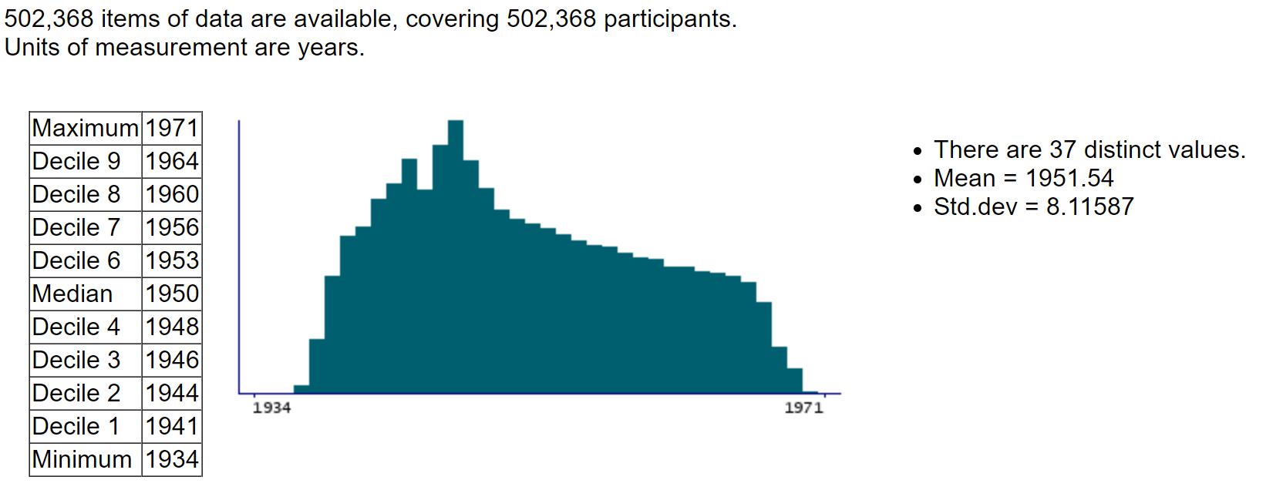
Year of birth 34-0.0

Slide 22
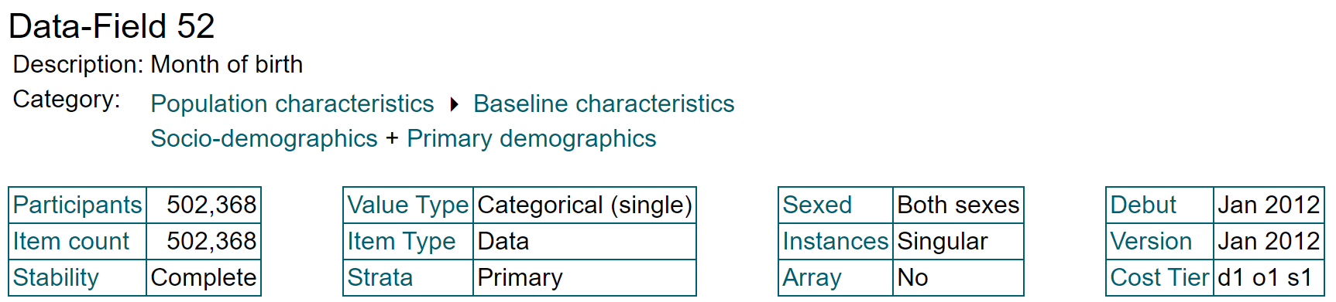
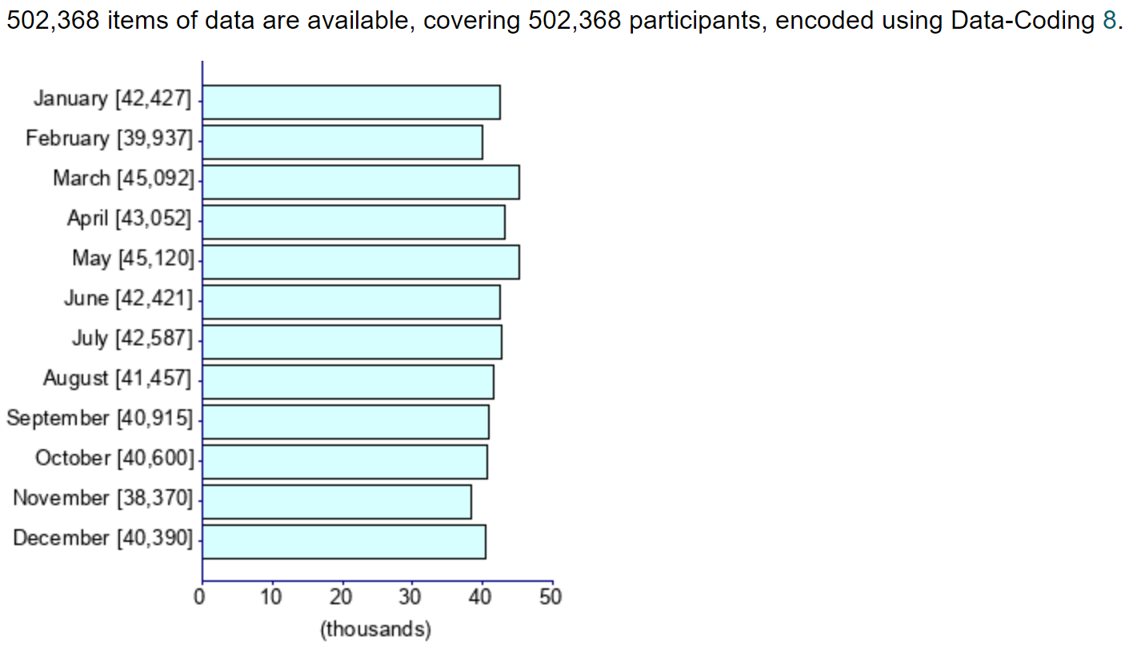
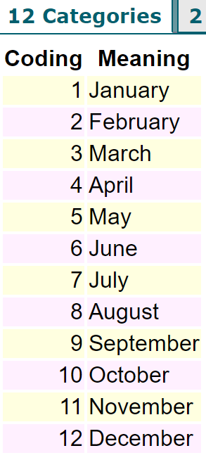
Month of birth

Slide 23
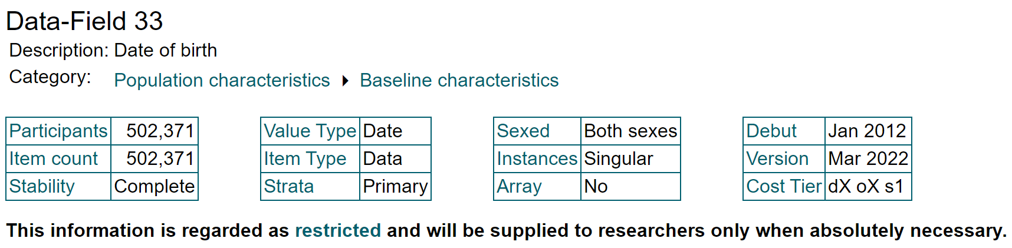
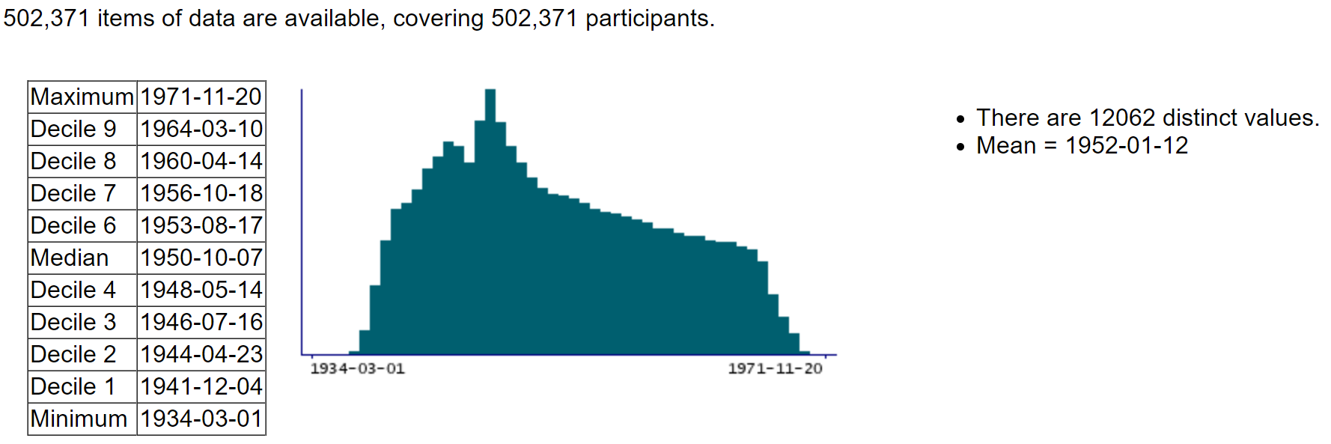
Date of birth

Slide 24
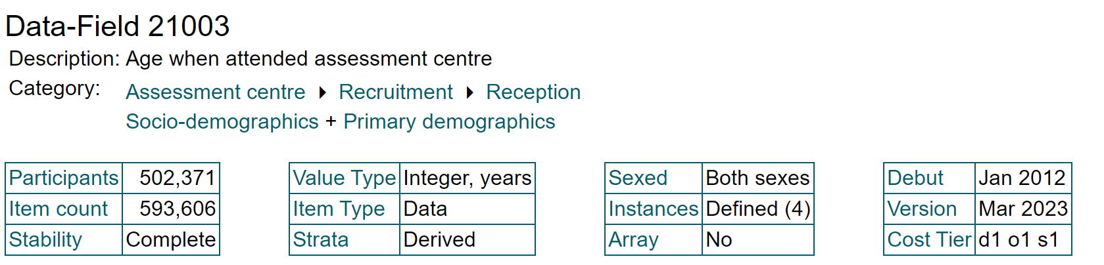
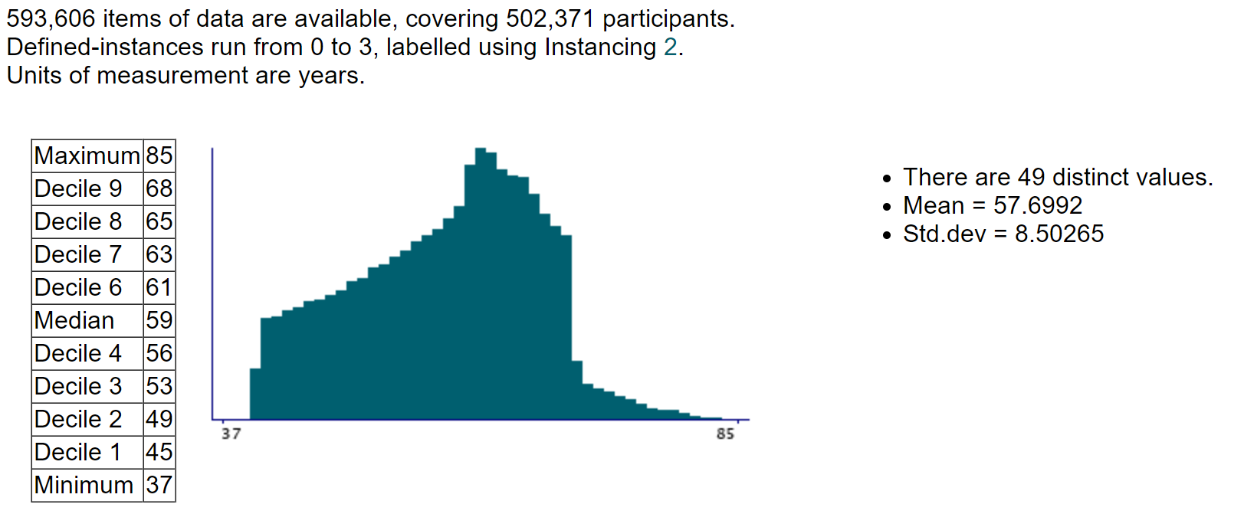
Age when attended assessment centre 21003-0.0

Slide 25
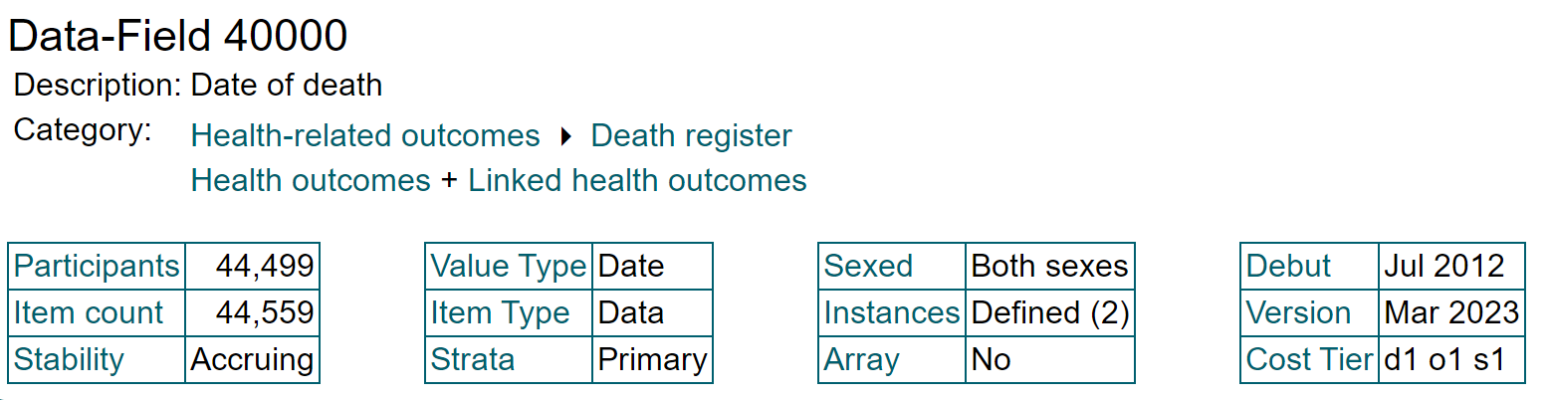
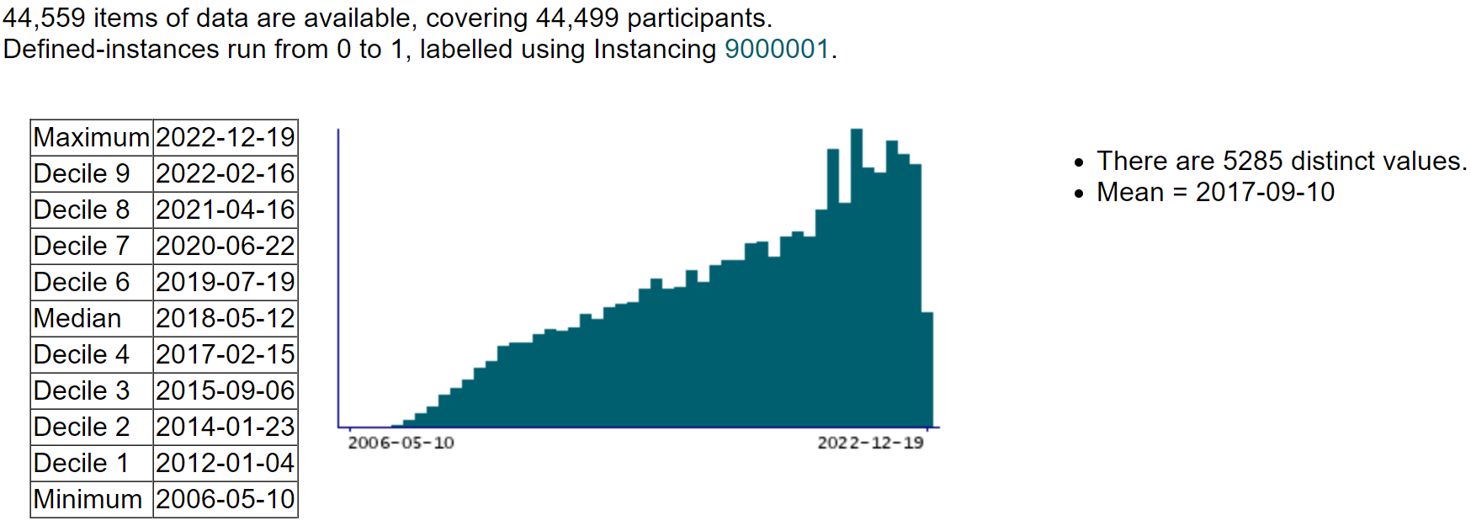
Date of death

Slide 26
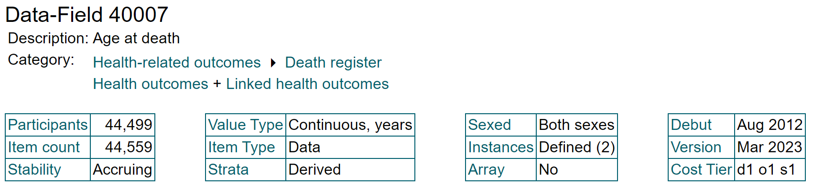
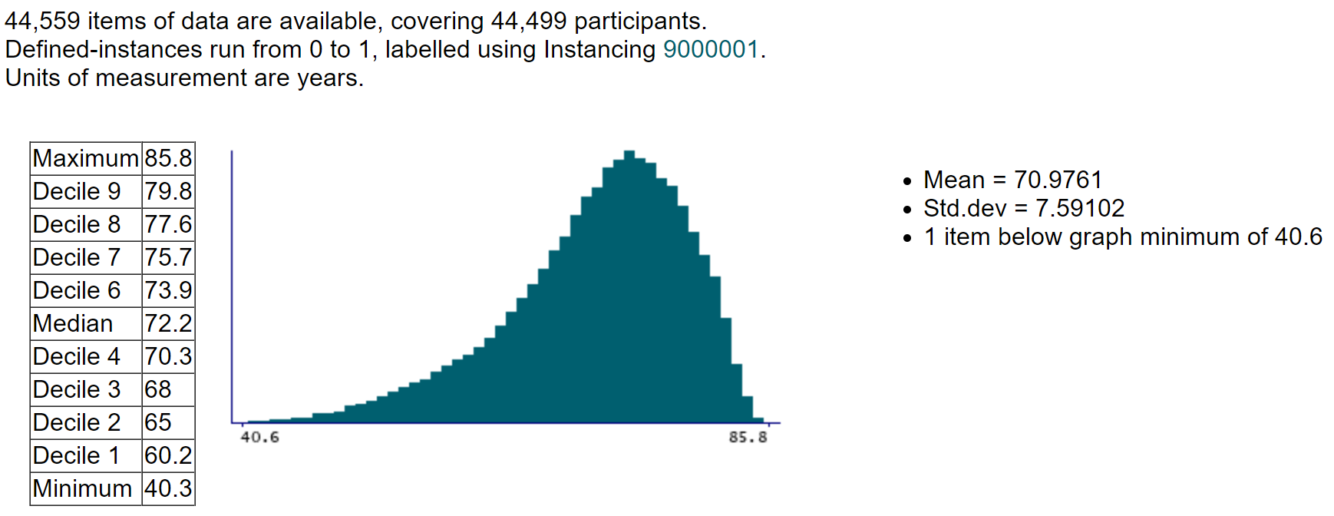
Age at death

Slide 27
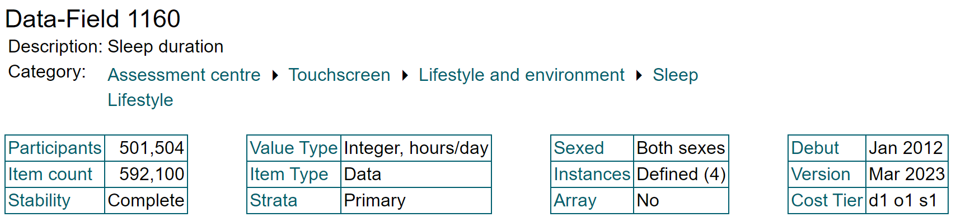
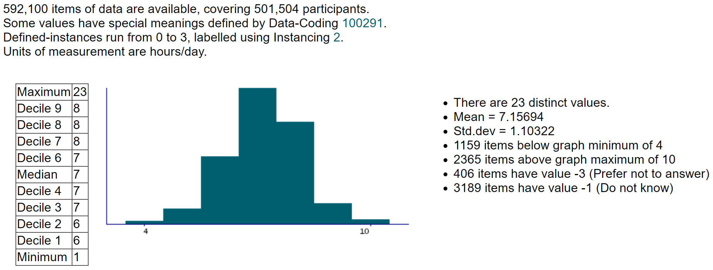
Sleep duration

Slide 28
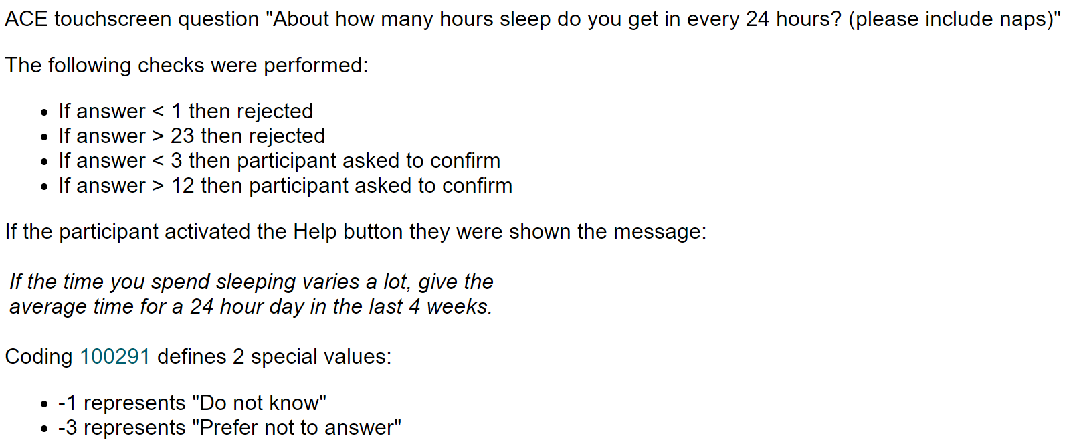
Sleep duration

Slide 29
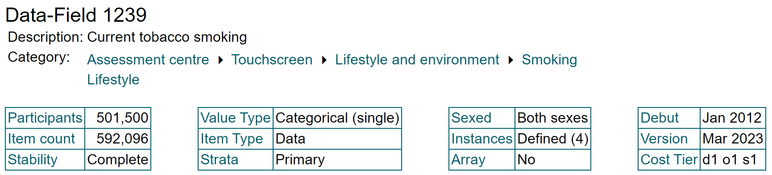
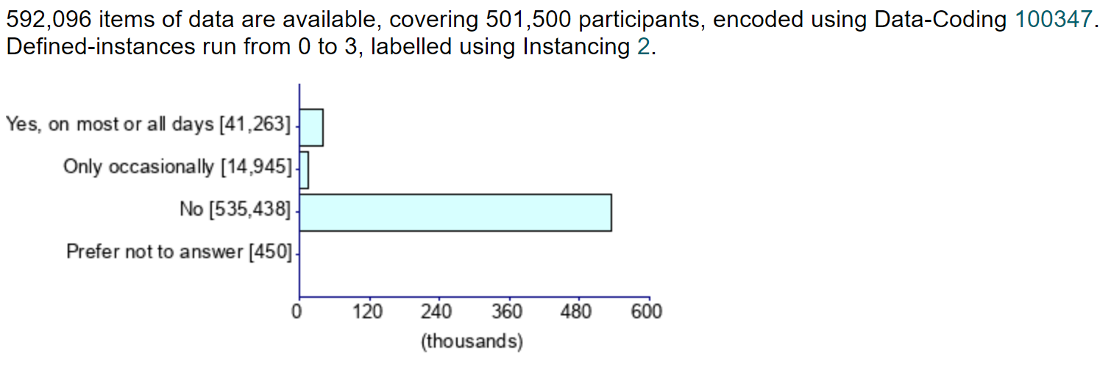
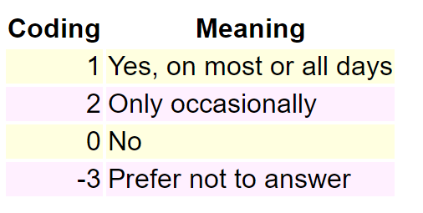
Current tobacco smoking

Slide 30
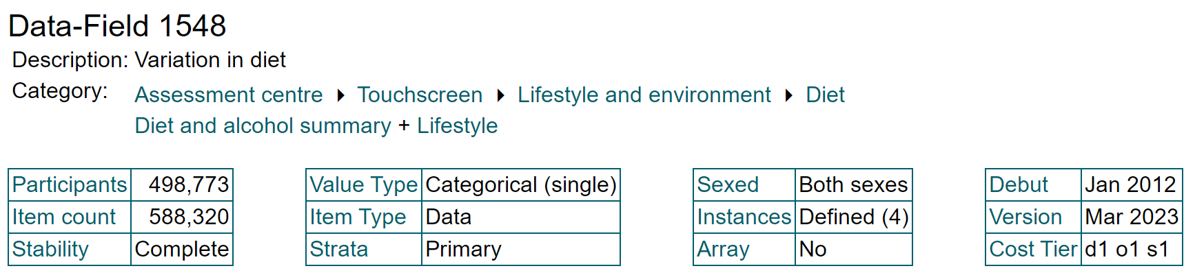
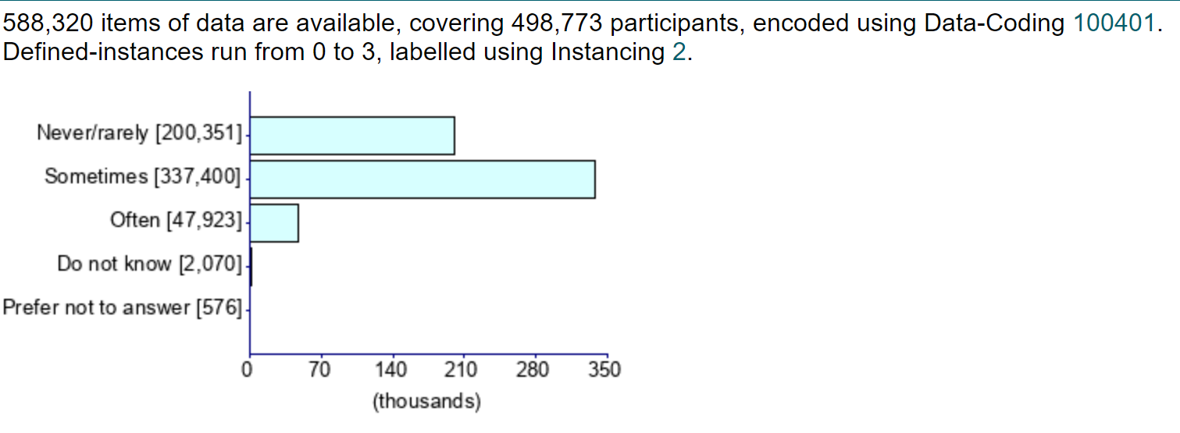
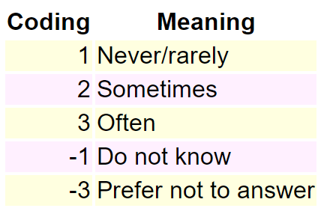
Variation in diet

Slide 31
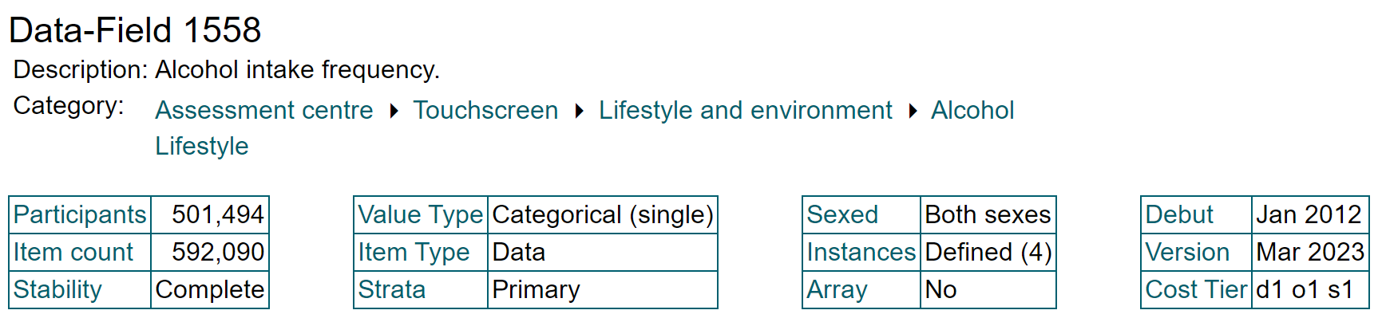
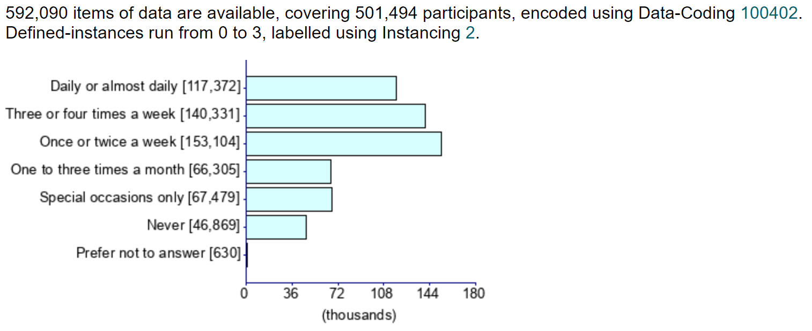
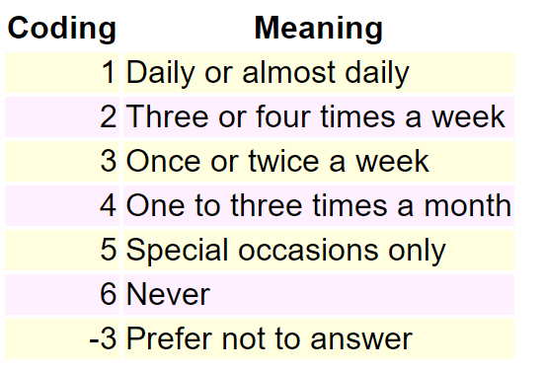
Alcohol intake frequency

Slide 32
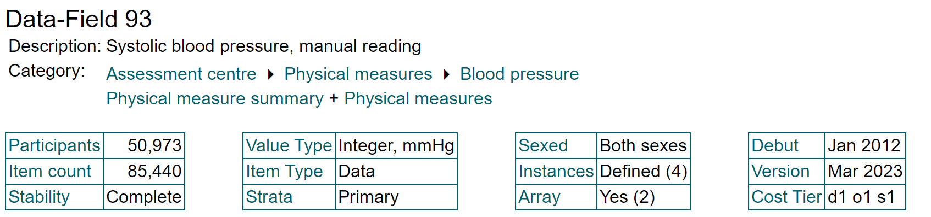
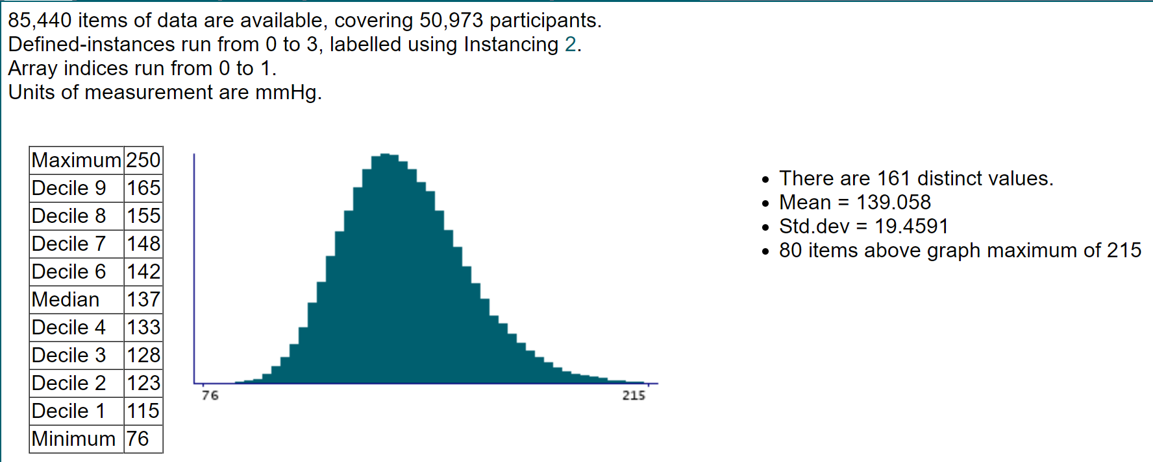
Systolic blood pressure, manual reading

Slide 33
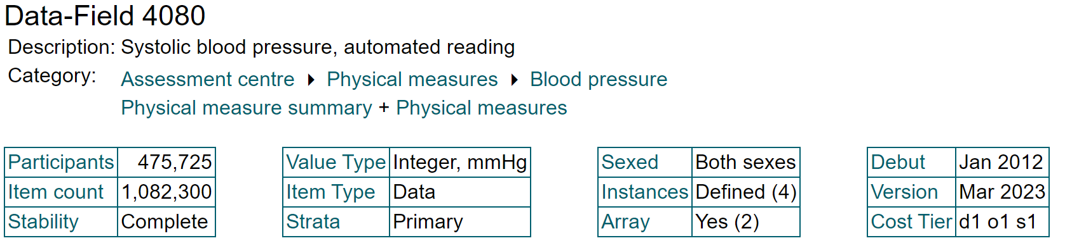
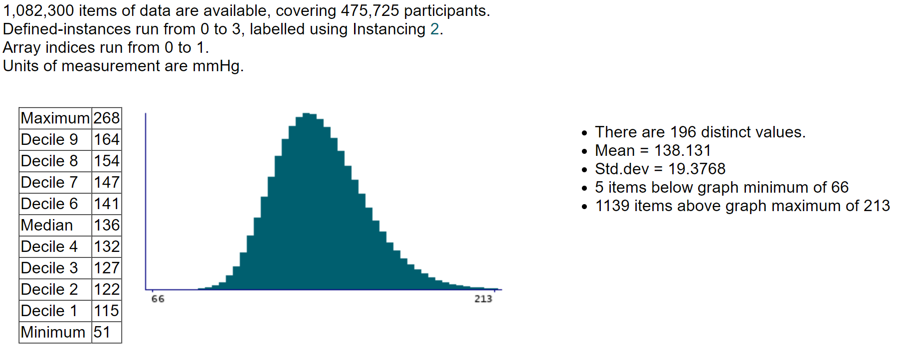
Systolic blood pressure, automated reading

Slide 34
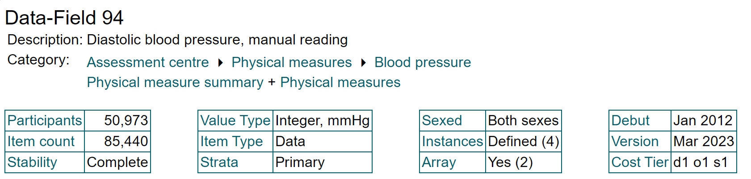
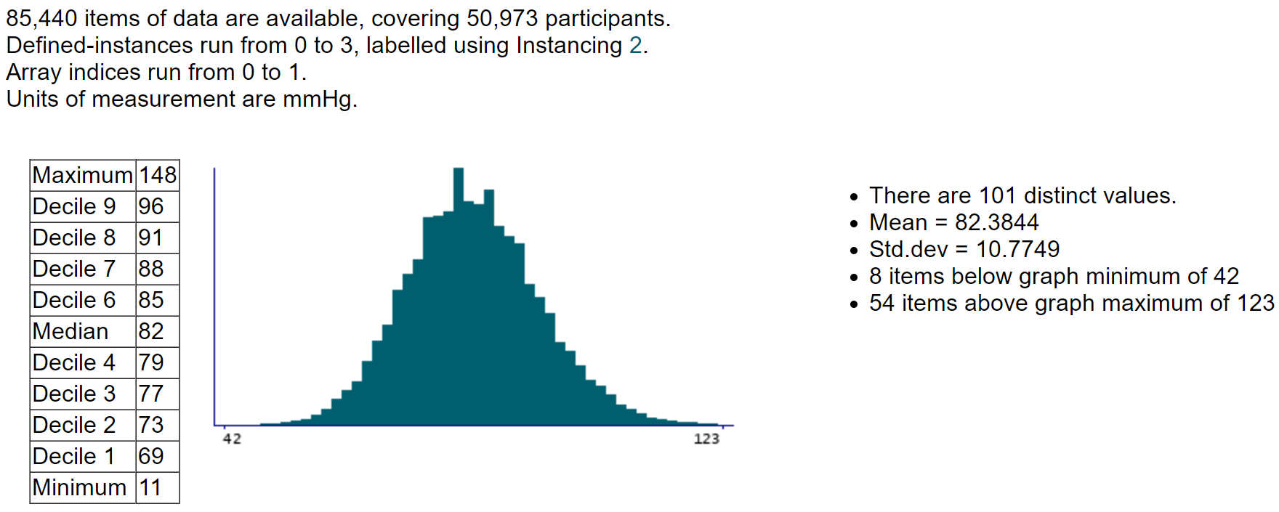
Diastolic blood pressure, manual reading

Slide 35
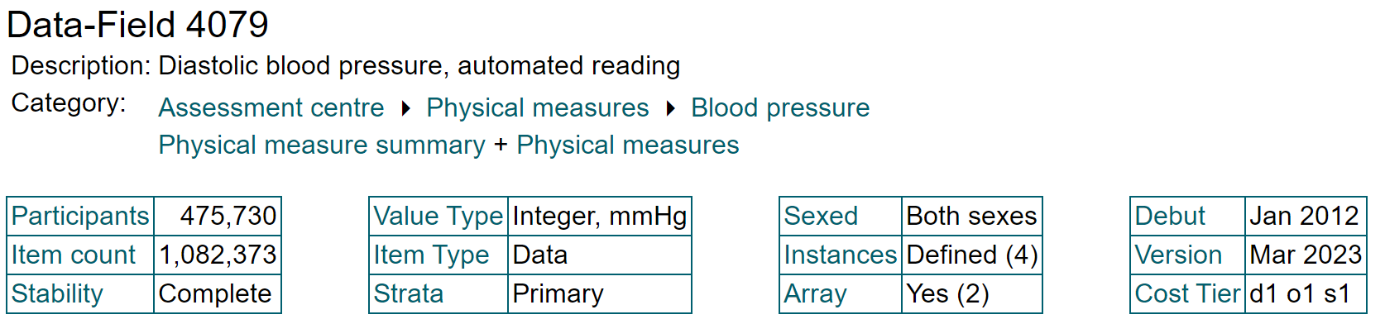
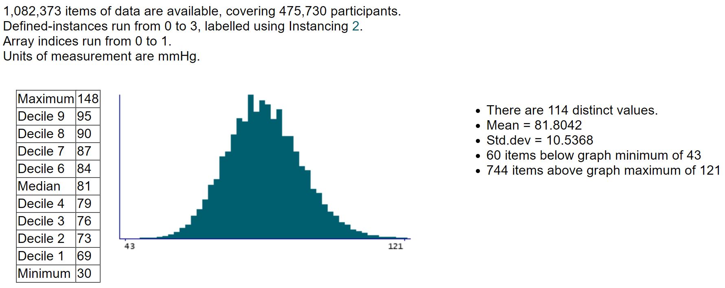
Diastolic blood pressure, automated reading

Slide 36
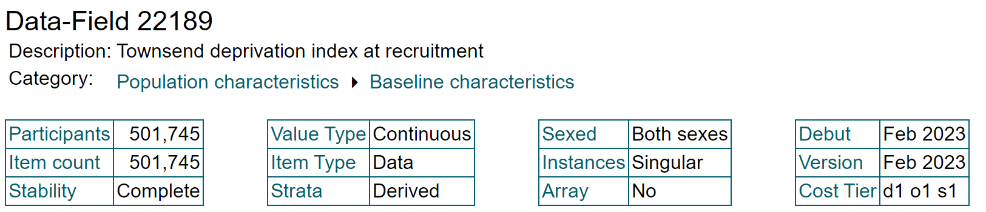

Townsend deprivation index at recruitment

Slide 37



Skin colour

Slide 38



Diabetes diagnosed by doctor

Slide 39



Qualifications

Slide 40



Frequency of strenuous sports in last 4 weeks

Slide 41



Seen doctor (GP) for nerves, anxiety, tension or depression

Slide 42



Wears glasses or contact lenses

Slide 43



Other eye problems

Slide 44


Slide 45


Slide 46


Slide 47


Slide 48


